Slide 1
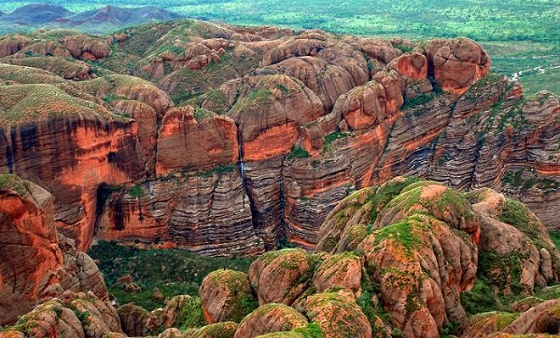
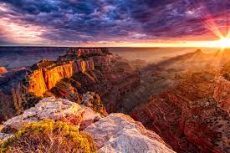
National Identity and Landscapes
How landscapes contribute to National Identity

Slide 2
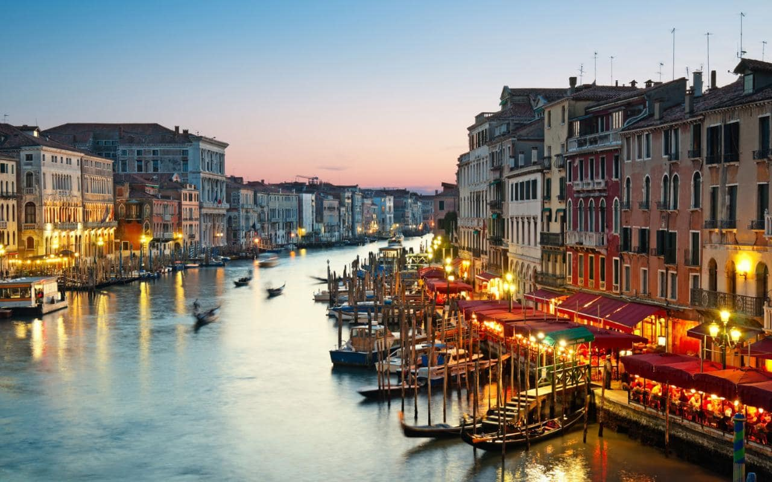
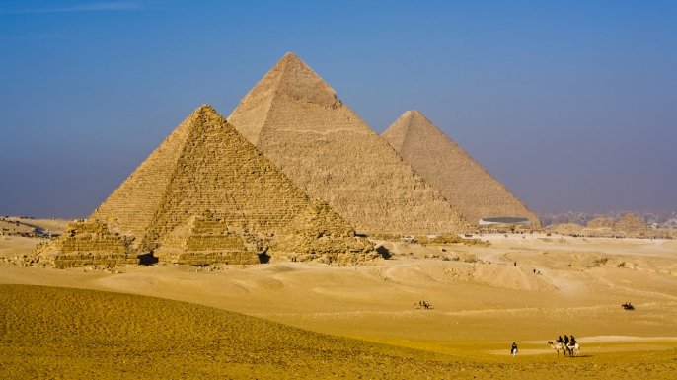
Valuing landscapes
Landscapes are a living record of our past and inspiration for our culture.
They provide a wide range of social, health and economic benefits

Slide 3
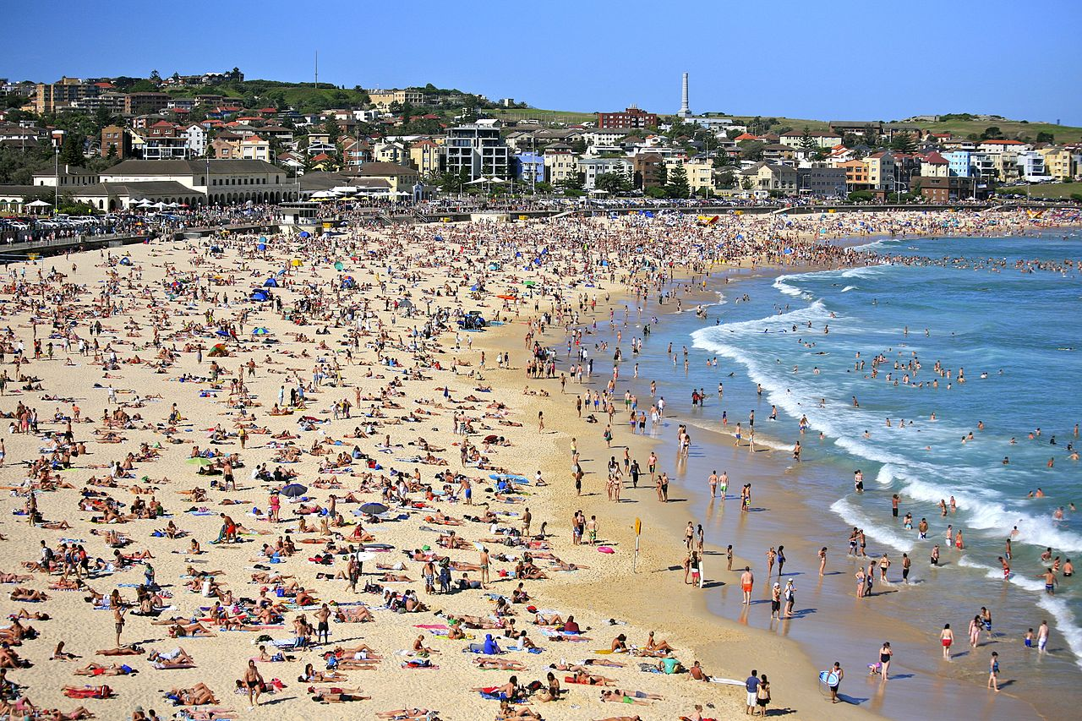
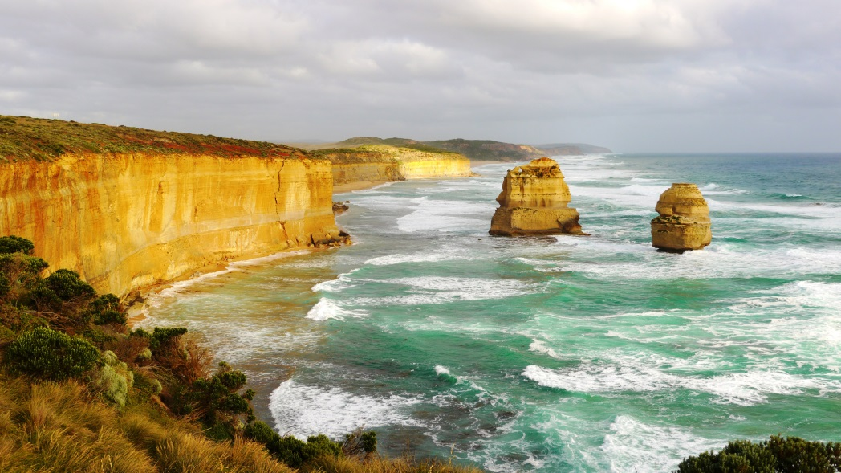
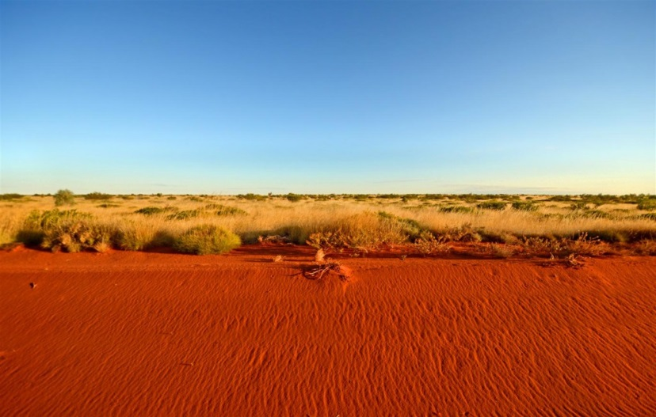
Powerful symbols of national identity
Landscapes are powerful symbols of national culture and society.
Our national anthem refers to ‘golden soil’ and being ‘girt by sea’ e.g surrounded by water. This conjures up images of a hot sandy deserts with red dirt surrounded by beautiful coastal landscapes.

Slide 4
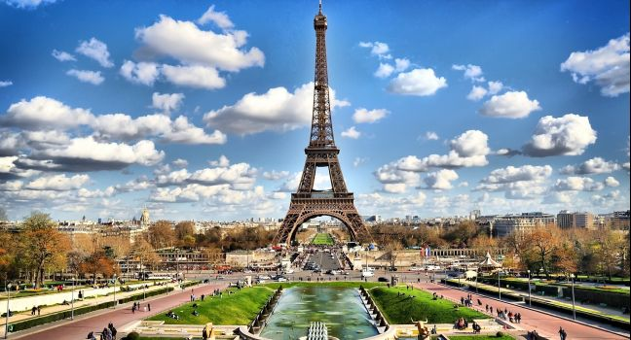
Iconic landscapes
Some landscapes are considered ‘iconic’ and the world recognises these landscapes as being central to that nation’s identity
Examples include: The Grand Canyon in the United States, The Eiffel Tower in France, the Pyramids of Giza in Egypt

Slide 5
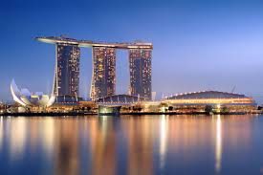
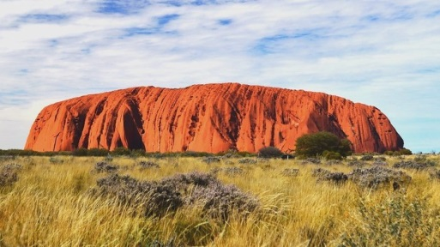
Aesthetic value
This is the idea of attractiveness and beauty
This depends of people’s perspectives, attitudes and personal values
For example thousands of people travel to Australia’s red centre to see landforms such as Uluru
Australian’s head overseas to see the managed and constructed landscapes of South East Asia.

Slide 6
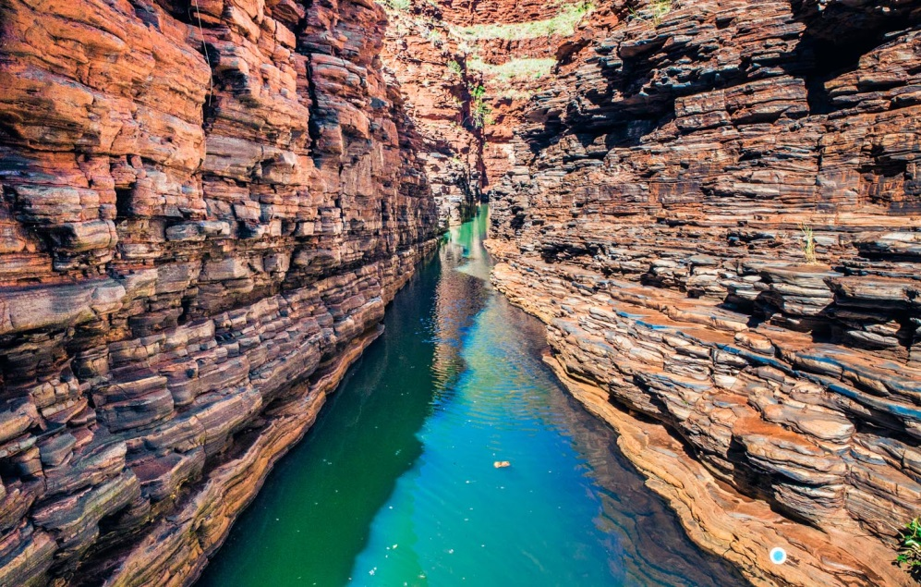
Emotional Value
People often develop emotional attachments to landscapes resulting from long term connections to that place.
This can be exceptionally strong for indigenous peoples
This may be through holidays we go on or through our recreational activities.
Landscapes are also a source of inspiration for many people such as painters and writers

Slide 7
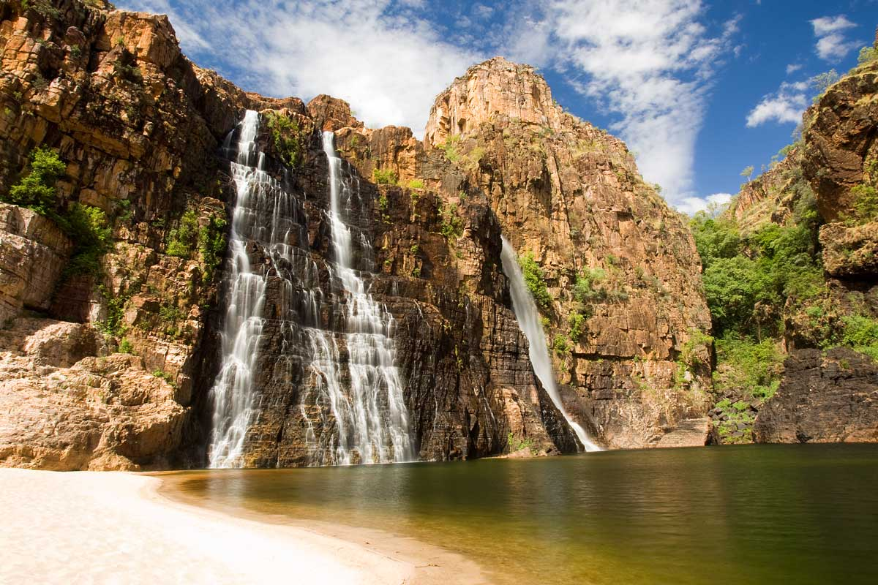
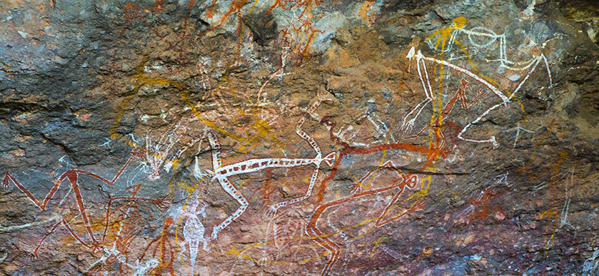
Spiritual Value
Landscapes hold special spiritual significance for some people.
Many Aboriginal and Torres Strait islanders have strong connections to rivers, mountains and trees
Through these features they connect by means of song and ritual to the Dreaming and ancestral creator beings.

Slide 8
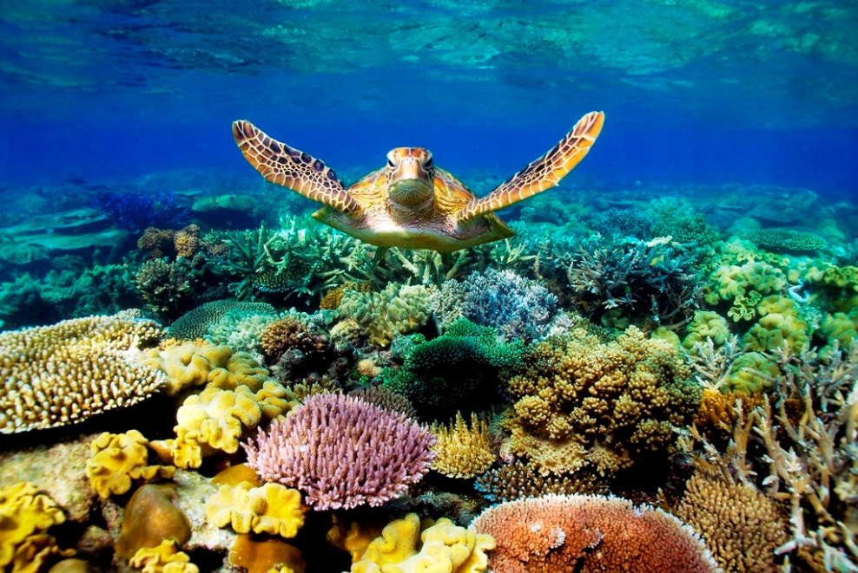
Economic Value
Agricultural, industrial and urban landscapes are the product of economic activity
Unique and spectacular landscapes are important tourist destinations and they generate employment and money into economies.
For example, 1.6 million people visit the Great Barrier Reef each year and Venice in Italy receives 22 million visitors a year.

